Slide 1
ELEC5620M Embedded Microprocessor System Design
Unit 2
Dr David Cowell Module Leader d.m.j.cowell@leeds.ac.uk
Prof Steven Freear

Slide 2
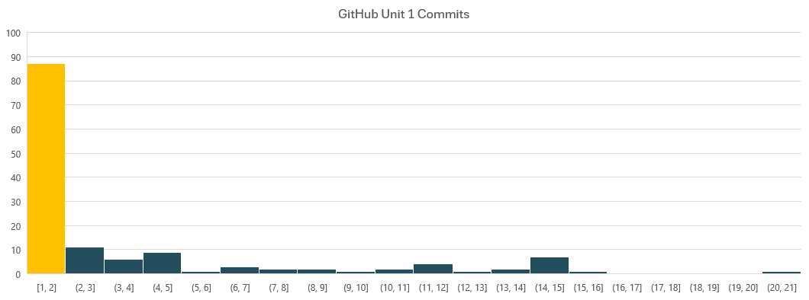
GitHub Classrooms
66 candidates have not signed up to GitHub Classrooms for ELEC5620M! 62 of 66 collected DE1-SoC Hardware. Cannot pass ELEC5620M without using GitHub. Not engaged. 87 candidates have not used Committed AND Pushed any code to GitHub! Commit code and push from GitHub desktop (See GitHub Intro lecture). Check GitHub.com code shows.

Slide 3
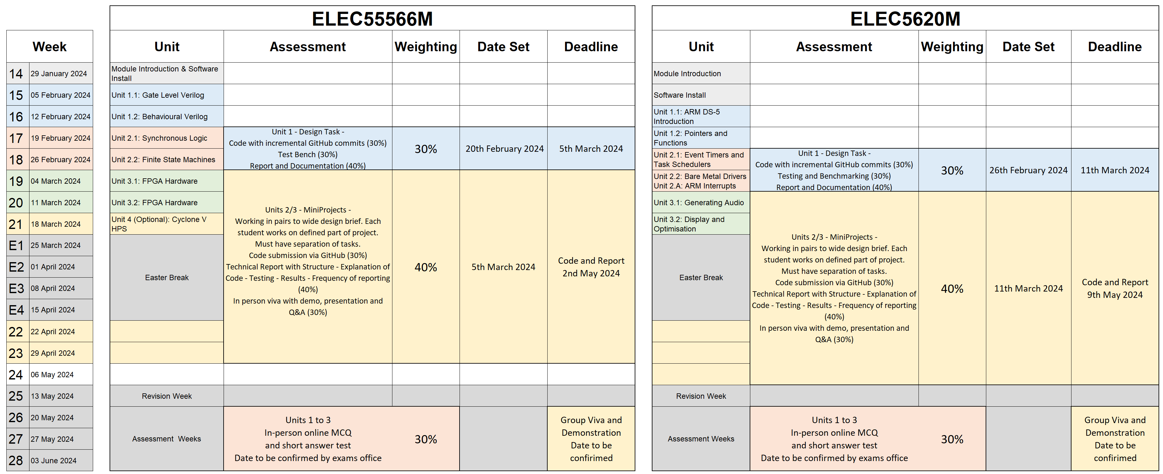
ELEC5620M Assessment Summary
ELEC5566M
Note overlapping assessments

Slide 4
ELEC5620M Embedded Microprocessor System Design
Assignment 1 Deadline 11th March 2024 at 2pm
Dr David Cowell Module Leader d.m.j.cowell@leeds.ac.uk
Prof Steven Freear

Slide 5
Minerva > ELEC5620M > Assessment and Feedback Assignment 1 – Unit 1: Design Task
Seven Segment Display Driver – Guided Design Task
Use Template repository provided ELEC5620M-Assessment1 Link on Minerva to create your repository
2 page written report
Incremental GitHub code commits of C code
Github online documentation using the readme
Read and follow guidance in assignment brief carefully
30% of module – Read rubric on Minerva and use to guide your submission.
Deadline Monday 13th March 2023 at 2pm
5% per day (or part of) penalty subtracted for late submission.
All request for extensions/mit. circs. from the Student Support Office (electronics@leeds.ac.uk)

Slide 6
Minerva > ELEC5620M > Assessment and Feedback Assignment 1 – Unit 1: Design Task
ELEC5620M Assignment 1 - Briefing Document The technical task, rules and information.
ELEC5620M Assignment 1 - GitHub Classrooms Repository Supplied code – You must incrementally commit your changes from GitHub Desktop – not web interface!
ELEC5620M Combined GitHub, Coding and Hardware Testing Rubric The marking rubric – read it to understand what qualities we are looking for to award marks.
ELEC5620M Assignment 1 - Turnitin Report Submission Your report is uploaded here.

Slide 7
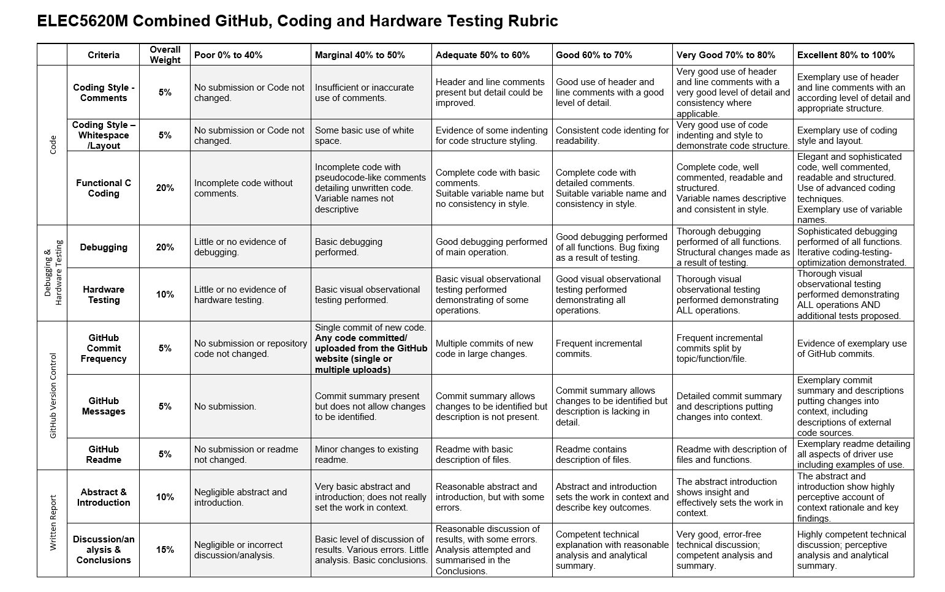
ELEC5620M Combined GitHub, Coding and Hardware Testing Rubric

Slide 8
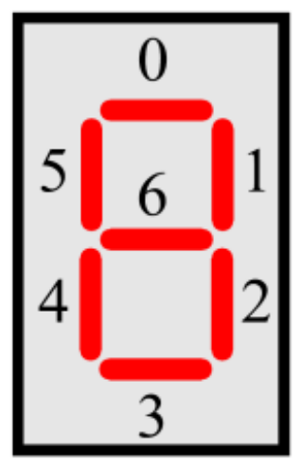
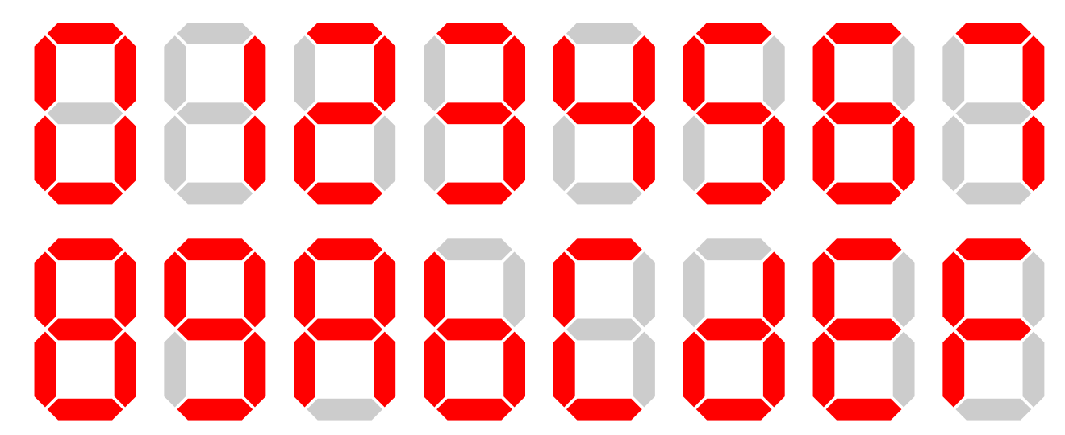
Assignment 1: Seven Segment Display Driver

Slide 9
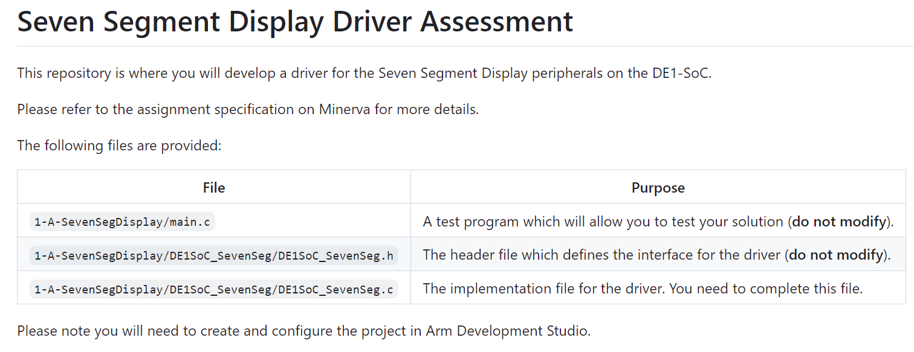
Assignment 1: Seven Segment Display Driver

Slide 10
Assignment 1: Seven Segment Display Driver

Slide 11
Unit 1.2:
Task recap

Slide 12
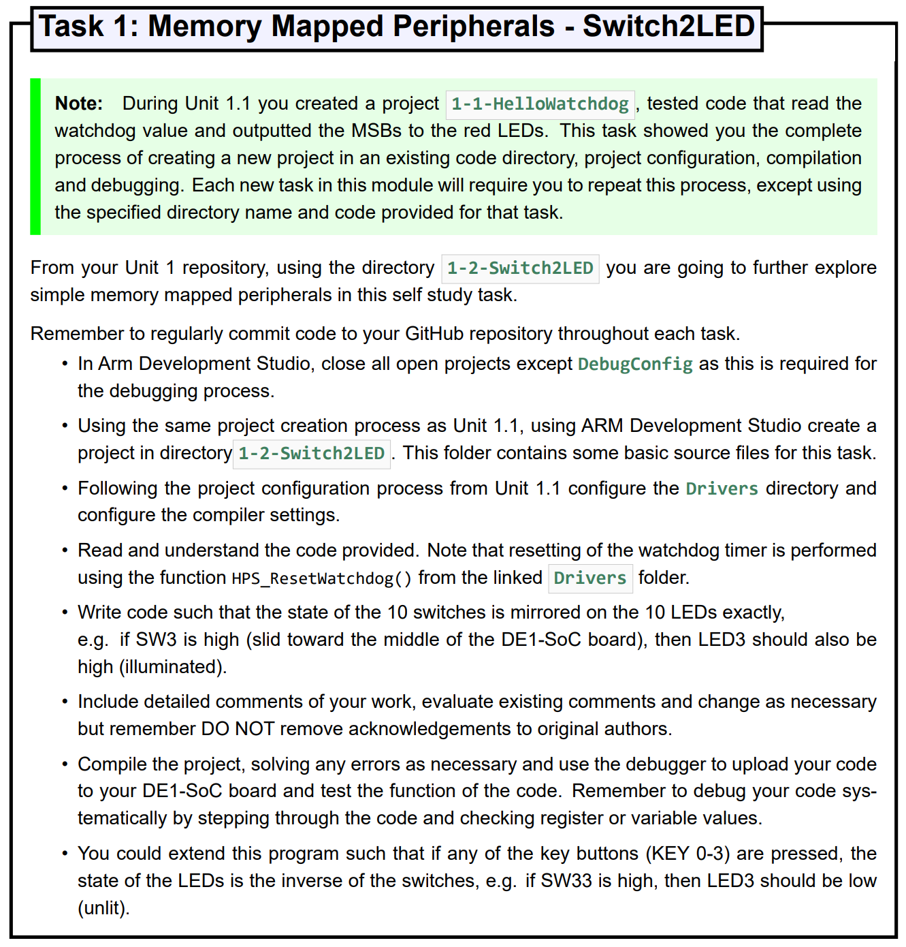
Unit 1.2 Task Recap
volatile unsigned int *ledr_ptr = (unsigned int *) 0xFF200000;
volatile unsigned int *switch_ptr = (unsigned int *) 0xFF200040;
int main(void) {
while (1) {
*ledr_ptr = *switch_ptr;
HPS_ResetWatchdog();
}
}
volatile unsigned int *ledr_ptr = (unsigned int *) 0xFF200000;
volatile unsigned int *switch_ptr = (unsigned int *) 0xFF200040;
#define LSC_BASE_KEYS ((unsigned char*)0xFF200050)
volatile unsigned int *key_ptr = (unsigned int *)LSC_BASE_KEYS;
int main(void) {
while (1) {
if(*key_ptr) *ledr_ptr = *switch_ptr;
else *ledr_ptr = ~*switch_ptr;
HPS_ResetWatchdog();
}
}

Slide 13
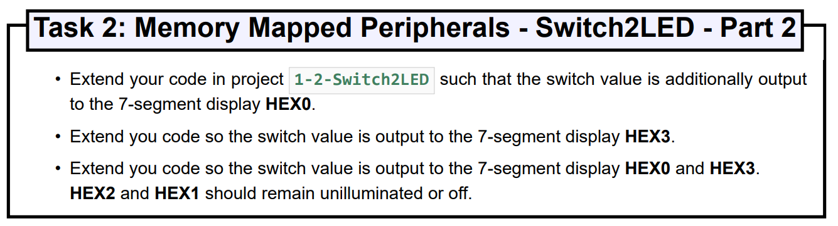
Unit 1.2 Task Recap
volatile unsigned int *ledr_ptr = (unsigned int *) 0xFF200000;
volatile unsigned int *switch_ptr = (unsigned int *) 0xFF200040;
volatile unsigned int *key_ptr = (unsigned int *) 0xFF200050;
volatile unsigned char *sevenseg03_ptr = (unsigned char *) 0xFF200020; // 7-segment HEX[3-0]
int main(void) {
while (1) {
if(*key_ptr) *ledr_ptr = *switch_ptr;
else *ledr_ptr = ~*switch_ptr;
*sevenseg03_ptr = *switch_ptr & (0x7F); // Display SW[6-0] on HEX[0]
*(sevenseg03_ptr + 3) = *switch_ptr & (0x7F); // Display SW[6-0] on HEX[3]
HPS_ResetWatchdog();
}
}

Slide 14
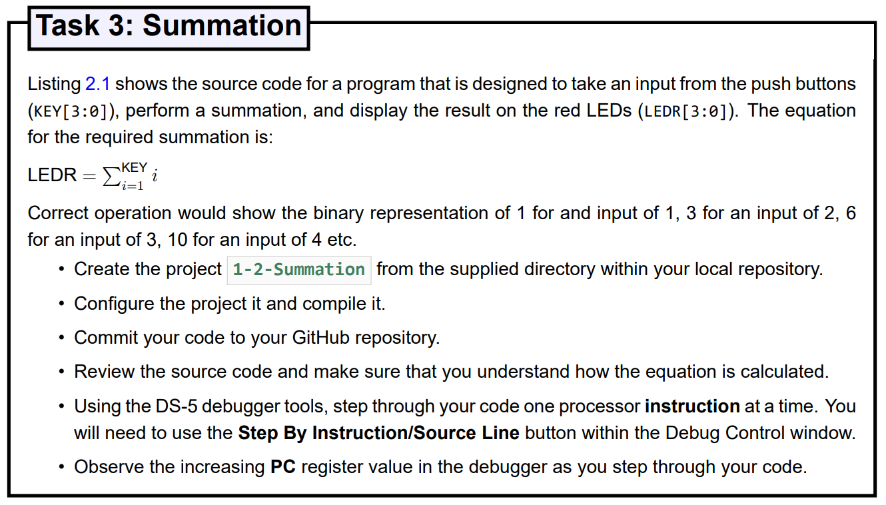
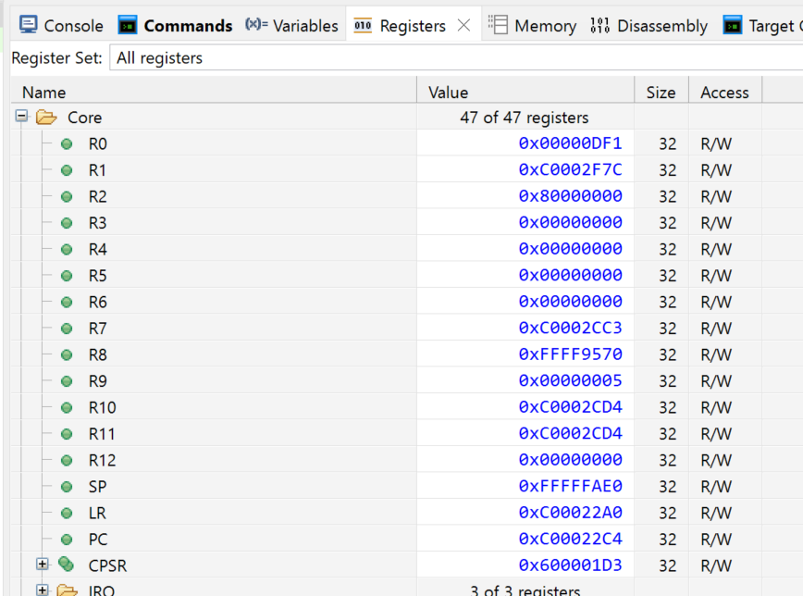
Unit 1.2 Task Recap

Slide 15
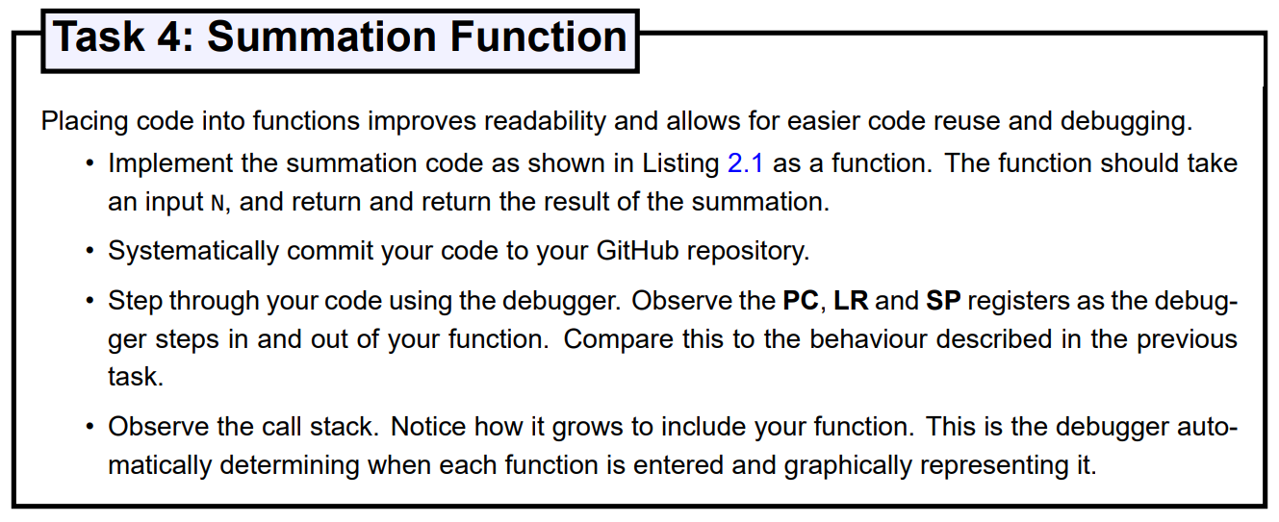
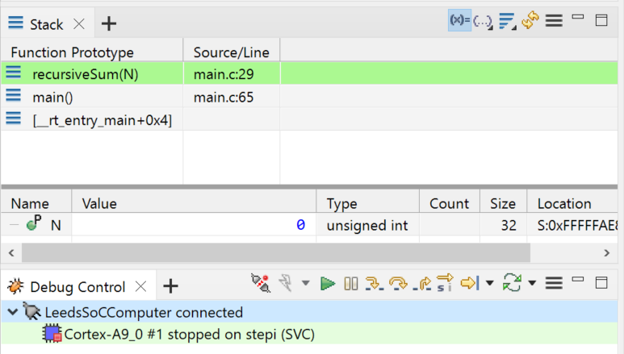
Unit 1.2 Task Recap
Click + and select Stack

Slide 16
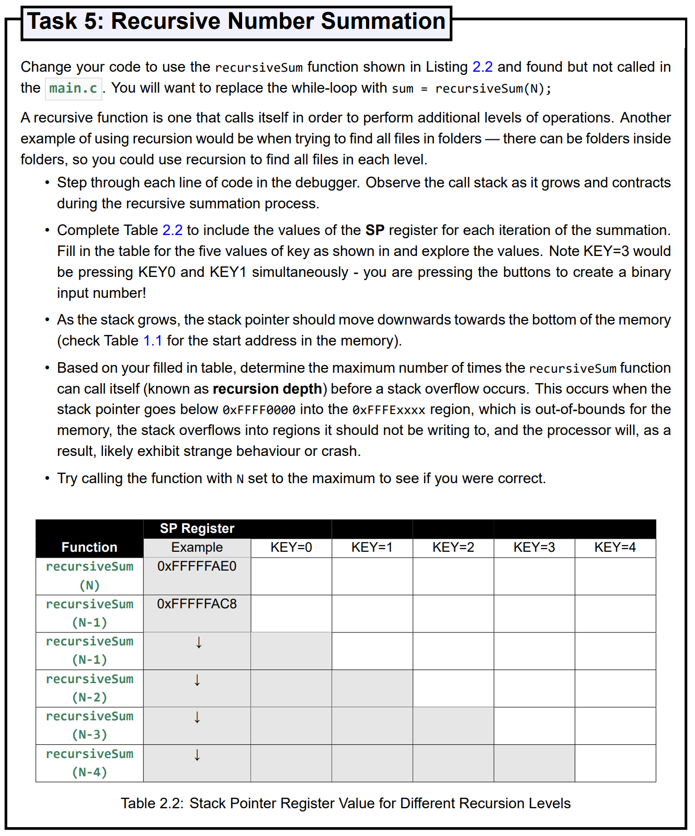
Unit 1.2 Task Recap

Slide 17
Unit 1.2 Task Recap
0xFFFF …FAE0 | …FAE0 | …FAE0 | …FAE0 | …FAE0
…FAC8 |  |  |  | …FAC8
 | …FAB0 |  |  | …FAB0
 |  | …FA98 |  | …FA98
 |  |  | …FA80 | …FA80
 |  |  |  | …FA68
18 byte difference
Stack is 0xFB00 bytes.
(0xFAB0 = 64,176)
64,256 / 18 = 2674
Testing: 2675 recursions
18 byte difference
6x 32-bit words

Slide 18
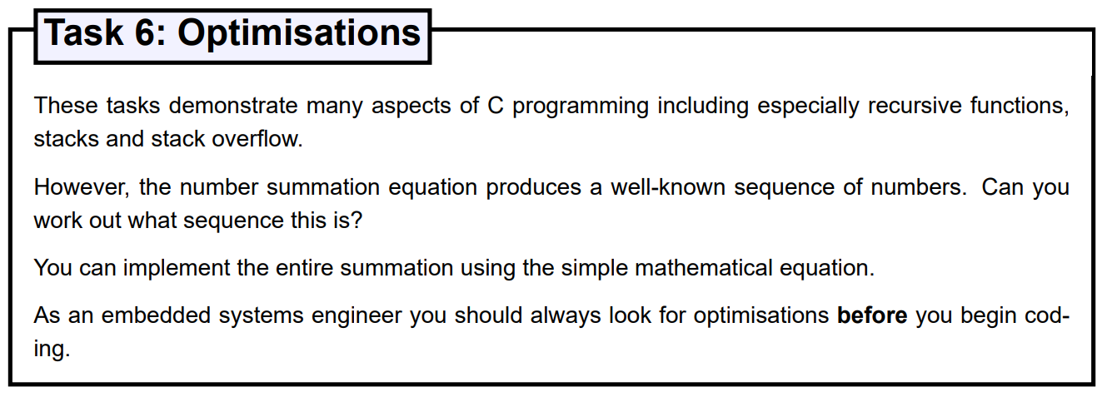
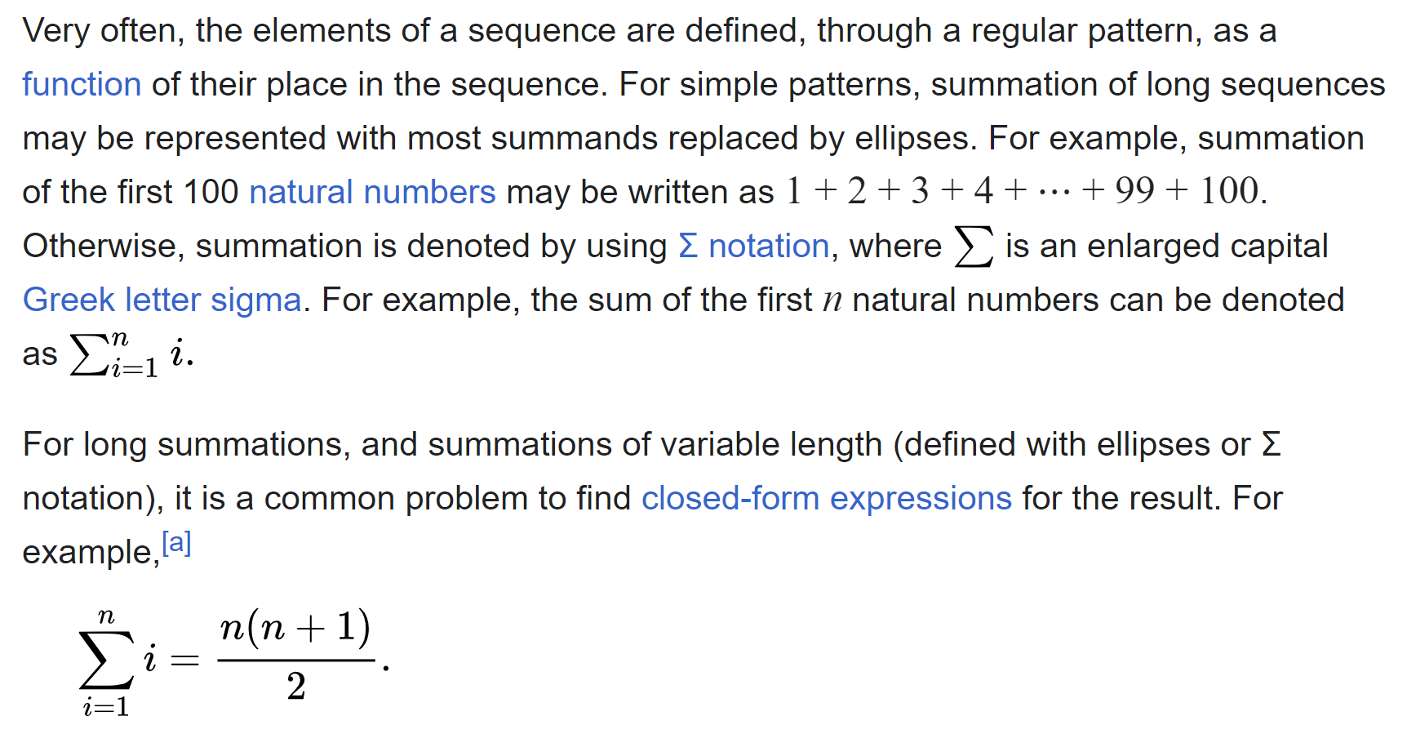
Unit 1.2 Task Recap
Source: https://en.wikipedia.org/wiki/Summation

Slide 19
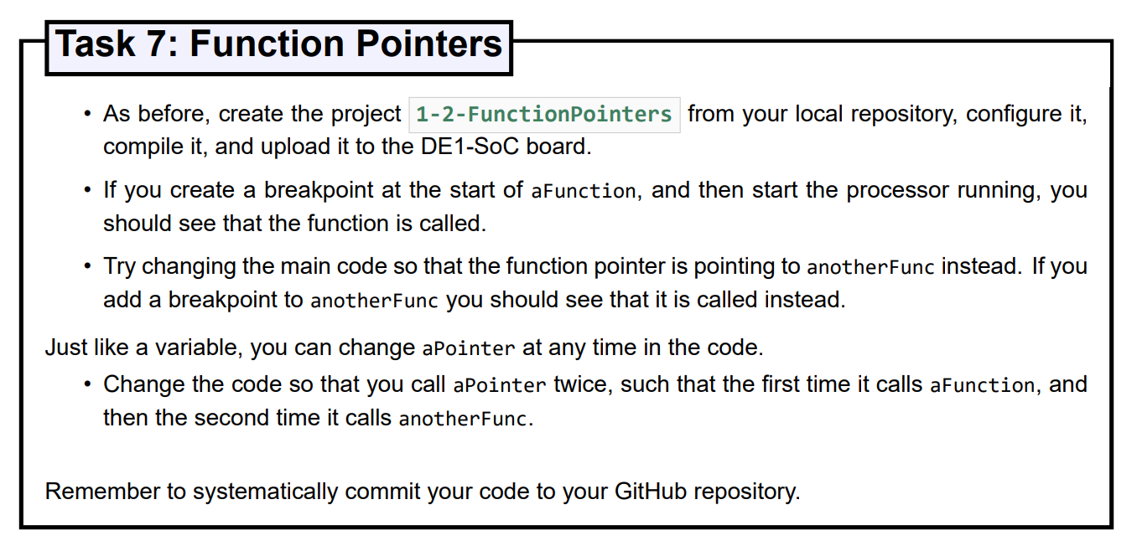
Unit 1.2 Task Recap
int main(void) {
// Create a pointer to aFunction.
TaskFunction aPointer = &aFunction;
// Create some inputs
int a = 4;
int b = 6;
// Create a pointer to aFunction.
TaskFunction aPointer = &aFunction;
int c = aPointer(a, b); // returns c = a + b
// Update pointer to anotherFunc.
aPointer = &anotherFunc;
int c = aPointer(a, b); // returns c = a * b
// Do nothing, forever.
while (1) {
HPS_ResetWatchdog();
}
}
// Define a new data type for a function pointers
typedef int (*TaskFunction)(int, int);
int aFunction(int a, int b) {
int c = a + b;
return c;
}
int anotherFunc(int a, int b) {
int c = a * b;
return c;
}

Slide 20
Unit 2.1
Structuring Software Flow
Polling
Non-Blocking vs Blocking
Timers
A9 Private Timer
Event Schedulers
Use GitHub Classrooms link on Minerva to create your personal Unit 2 repository!

Slide 21
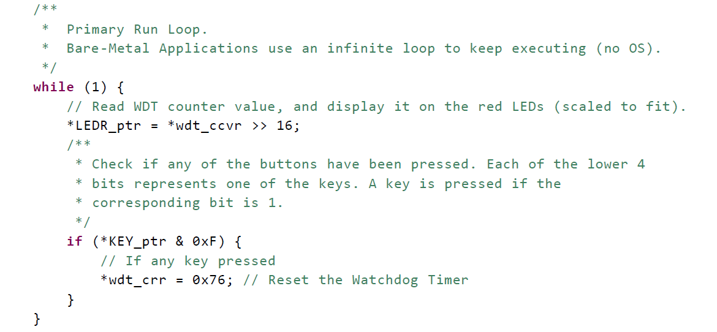
Background: Software Flow Polling 1-1-HelloWatchdog

Slide 22
Background: Software Flow Polling 1-1-HelloWatchdog

Slide 23
Background: Software Flow Polling 1-1-HelloWatchdog
if(false)

Slide 24
Background: Software Flow Polling 1-1-HelloWatchdog
if(true)

Slide 25
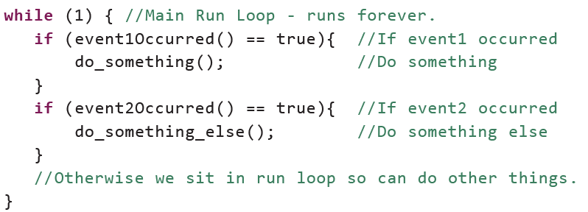
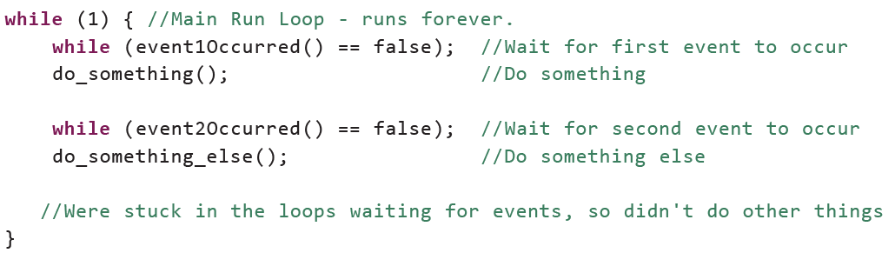
Background: Software Flow Non-blocking vs Blocking
Non-blocking
Bypasses if event not occurred
Blocking
Waits for event to occur

Slide 26
Background: Software Flow Non-blocking vs Blocking
Non-blocking
Bypasses if event not occurred
WAIT
Blocking
Waits for event to occur
WAIT

Slide 27
Event Timers
Watchdog Timer – Resets system when reaches zero!
A9 Private Timers
Cyclone V SoC Hard Processor System (HPS) has MANY other timers.
Timers allow event control with precise timing, delay, frequency etc

Slide 28
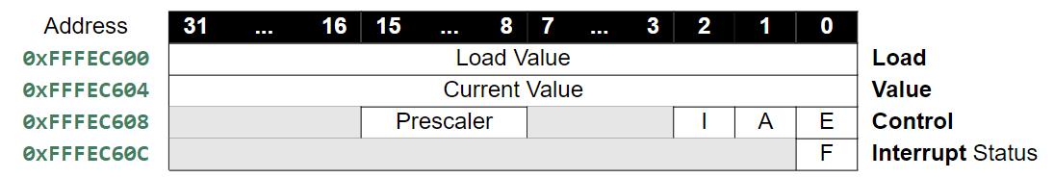
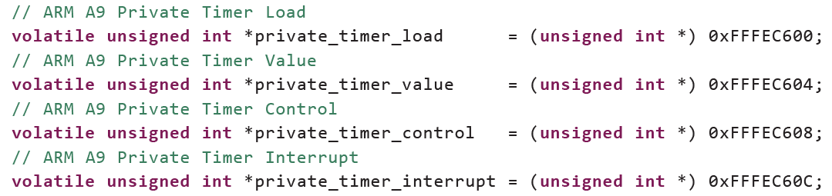
ARM A9 Private Timer Pointers

Slide 29
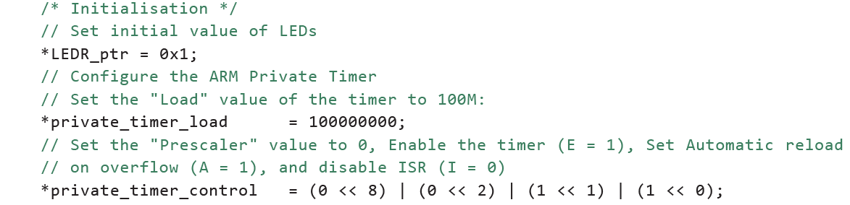
ARM A9 Private Timer Control – Bit manipulation
E 1<<0 0001 | Bitwise OR
A 1<<1 0010 |
I 0<<2 0000 |
Prescaler 0<<8 000000000 |
000000011

Slide 30
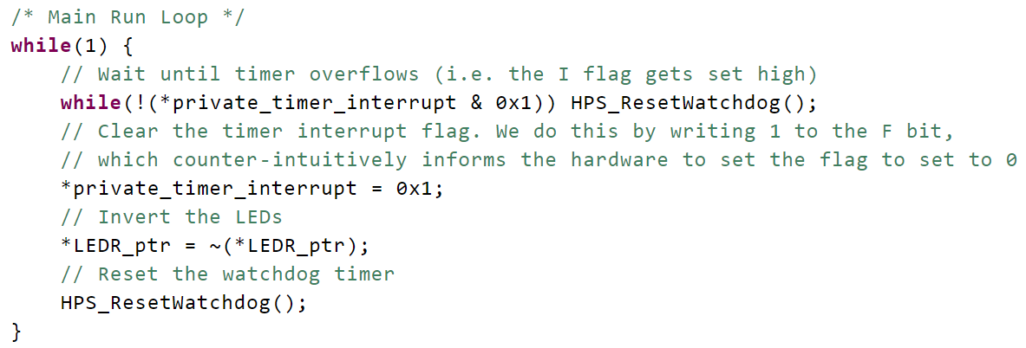
ARM A9 Private Timer Example use

Slide 31
Controlling Timed Events
unsigned int lastBlinkTimerValue = *private_timer_value;
const unsigned int blinkPeriod = 100000000;
while(1) {
// Read the current time
unsigned int currentTimerValue = *private_timer_value;
// Check if it is time to blink
if ((lastBlinkTimerValue - currentTimerValue) >= blinkPeriod) {
*LEDR_ptr = ~(*LEDR_ptr); // Invert the LEDs
lastBlinkTimerValue = lastBlinkTimerValue - blinkPeriod;
}
}

Slide 32
Controlling Timed Events
unsigned int lastBlinkTimerValue = *private_timer_value;
const unsigned int blinkPeriod = 100000000;
while(1) {
// Read the current time
unsigned int currentTimerValue = *private_timer_value;
// Check if it is time to blink
if ((lastBlinkTimerValue - currentTimerValue) >= blinkPeriod) {
*LEDR_ptr = ~(*LEDR_ptr); // Invert the LEDs
lastBlinkTimerValue = lastBlinkTimerValue - blinkPeriod;
}
}
Unsigned
Wraparound
Arithmetic
e.g.
0x0001
-0x0002
=0xFFFF

Slide 33
Task: Controlling Multiple Events
unsigned int lastBlinkTimerValue[2] = {0,0};
const unsigned int blinkPeriod[2] = {100000000,5000};
while(1) {
// Read the current time
unsigned int currentTimerValue = *private_timer_value;
// Timer loop 1
if ((lastBlinkTimerValue[1] - currentTimerValue) >= blinkPeriod[1]) {
*LEDR_ptr = ~(*LEDR_ptr); // Invert the LEDs
lastBlinkTimerValue[1] = lastBlinkTimerValue[1] – blinkPeriod[1];
}
// Timer loop 2
if ((lastBlinkTimerValue[2] - currentTimerValue) >= blinkPeriod[2]) {
...

Slide 34
Task Schedulers
//Define new data type for function which takes an int parameter and returns nothing.
typedef void (*TaskFunction)(int);
void toggle (int id){
volatile unsigned int *LEDR_ptr = (unsigned int *) 0xFF200000;
unsigned int ledVal = *LEDR_ptr; //Read
ledVal = (ledVal ^ (1 << id)); //Modify. Use XOR to toggle LED "id"
*LEDR_ptr = ledVal; //Write
}
TaskFunction taskFunctions[taskCount] = {&toggle,&toggle,&toggle,&invert};
for (taskID = 0; taskID < taskCount; taskID++) {
if ((taskLastTime[taskID] - currentTimerValue) >= taskInterval[taskID]) {
// When the task is ready to be run, call function, using Function Pointer
taskFunctions[taskID](taskID);
taskLastTime[taskID] = taskLastTime[taskID] - taskInterval[taskID];
}
}

Slide 35
Read-Modify-Write Bit manipulation
void toggle (int id){
volatile unsigned int *LEDR_ptr = (unsigned int *) 0xFF200000;
unsigned int ledVal = *LEDR_ptr; //Read
ledVal = (ledVal ^ (1 << id)); //Modify. Use XOR to toggle LED "id"
*LEDR_ptr = ledVal; //Write
}
Clearing a bit
Use the bitwise AND operator (&) (combined bitwise NOT (~) and bitshift left (<<)) to set the n-th bit of ledVal to 0.
ledVal = (ledVal & ~(1 << n));
Setting a bit
Use the bitwise OR operator (|)
(combined bitshift left (<<))
to set n-th bit of ledVal to 1.
ledVal = (ledVal | (1 << n));
Toggling a bit
Use the bitwise XOR operator (^) (combined bitshift left (<<))
to toggle the n-th bit of ledVal.
ledVal = (ledVal ^ (1 << n));
Changing the n-th bit to x
One method is to clear the specific bit, then set the specific bit as above.
ledVal = (ledVal & ~(x << n)) | (1 << n));
Checking a bit
Use bitshift right (>>)) to move n-th bit to Least Significant Bit (LSB) then check bit using a bitwise AND operator (&)
ledVal = ((ledVal >> n) & 0x1);

Slide 36
Questions?

